Slide 1
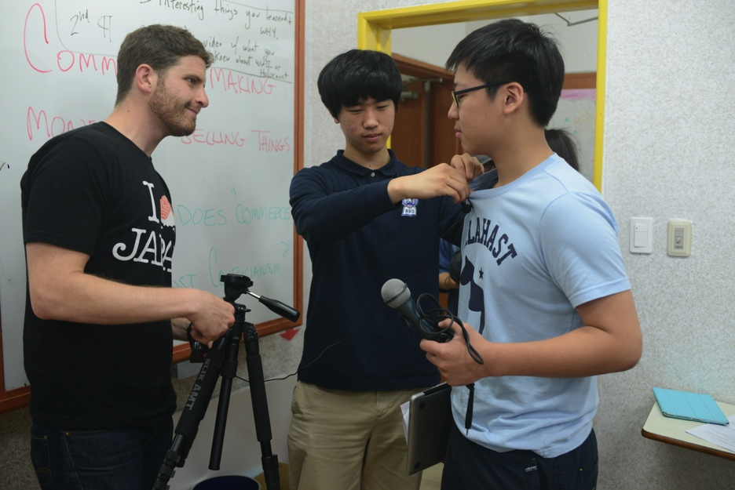
Teaching Your Students to Design High Quality Videos
Why should students make videos?
How to teach students to make high quality videos for projects in your class
Video as summative assessment
Pre-Production
Production
Post-Production
How to get started / resources
What should your expectations be?
Any teacher in any subject area can do this from Grade 12 down to Pre-K
Short learning curve for either you or the students

Slide 2
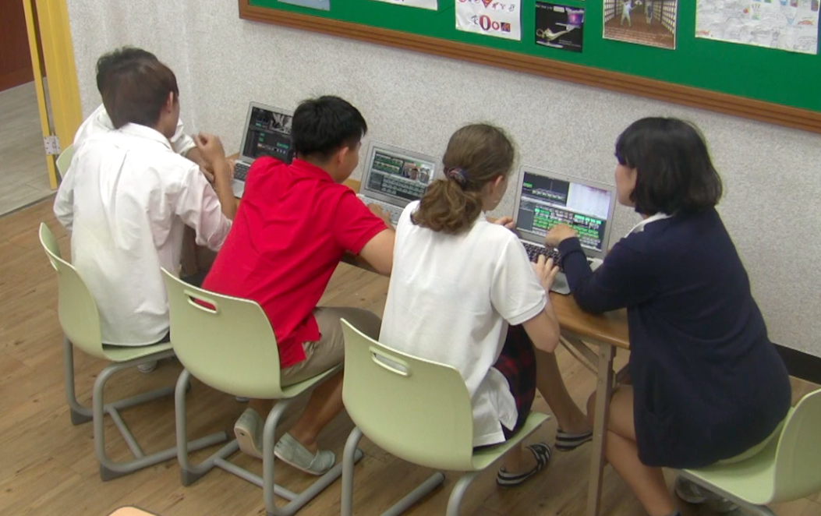
Why Make Videos?
For the kids:
Differentiation
Student-Centered
Alternative assessment to tests
To demonstrate learning
Shy kids will surprise you

Slide 3
Why Make Videos?
For the kids:
Kids love to see each other on film
Critical thinking, problem solving, creativity, fun
Group work = long list of benefits
Students must learn to use this technology anyway just to get into competitive universities some day
English skills improve
Practice practice practice and re-film until speaking and English are perfect

Slide 4
Why Make Videos?
For your school:
Public Relations
Future students, families, and potential teacher hires might see this and choose your school
Videos posted to youtube & facebook are very popular and will receive many hits giving your students a larger audience

Slide 5
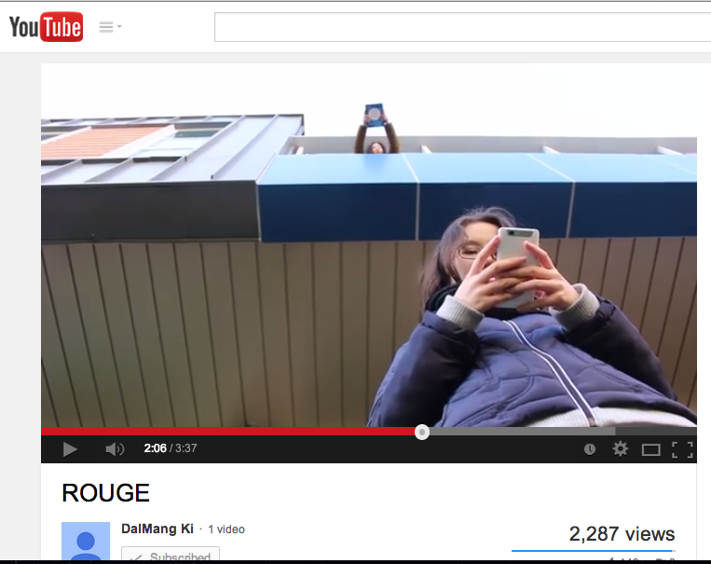
Why Make Videos?

Slide 6
Why Make Videos?
For you:
Teacher collaboration with the media teacher or other disciplines
Ex: US History & American Lit teamed up for Roaring 20’s videos
Ex: 2nd grade & MMJ2 teamed up for a music video

Slide 7
Why Make Videos?
For you:
Big for your portfolio and resume
Links on the internet so easy to put into online portfolio
You must show you and your students can use tech in order to be competitive in the job market
Again, ANY subject or grade level can make a video. Let’s talk about possible projects:

Slide 8
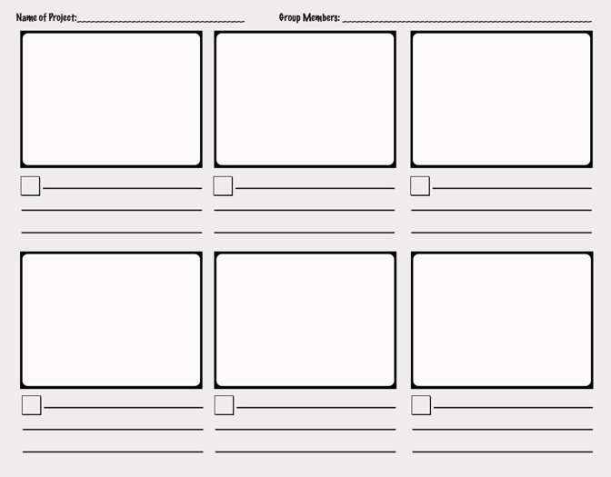
How to Create Videos: Pre-Production
Introduce the project
Use sample rubrics from me or other teachers, or find some online
Assign groups or let them choose
Planning / brainstorming in small groups
Storyboard
Write scripts (depends on the project)
Prepare for filming
Where to film
Equipment (explained in detail on next slide)
Props, make-up, consistent clothing or costumes brought each day

Slide 9
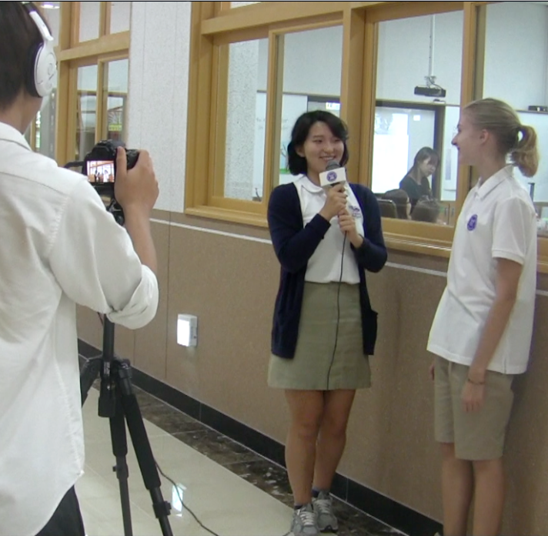
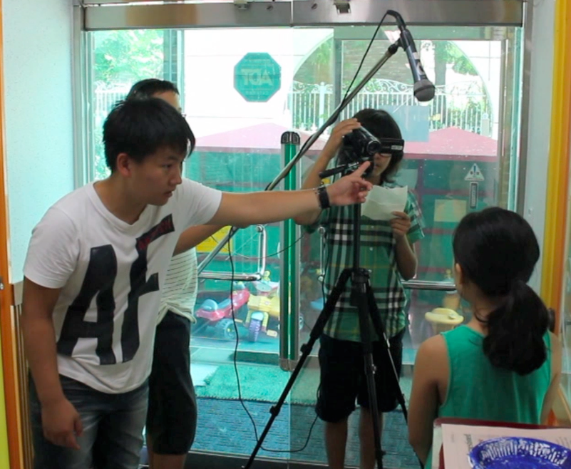
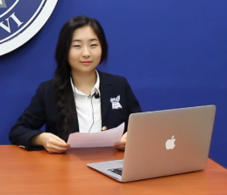
How to Create Videos: Production
Use proper equipment
Tripods (or DIY tripods) are a must
Mic’s if possible (boom, hand-held, lavaliere)
If no mic’s – record scenes close to the camera in rooms with good acoustics
Lighting

Slide 10
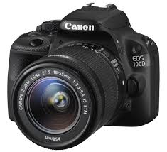
How to Create Videos: Production
Film the scenes
Students should have storyboards and scripts out while filming
Students often have nice cameras
Canon SLR’s with a mic jack are preferable
Students should review film before stopping
Re-film over and over if necessary
Record 2-3 extra seconds at beginning and end of shot
Have a video production checklist out at all times while filming

Slide 11
How to Create Videos: Post-Production
Edit
imovie or Windows Movie Maker
All kids have access to this on their laptops
Advanced students can use Final Cut Pro or Sony Vegas
Students should pend A LOT of time editing
Sound effects, music, perfect English in text, text on screen long enough to read, smooth transitions, etc. etc.
Try to consult with students during the editing process and work them toward that perfect final product
Just like you might do with a lengthy essay or project, make a rough draft or two due before the actual due date
Once rough drafts are constructively criticized, final drafts can be ready pretty soon

Slide 12
How to Get Started
Take copies of this PPT for a simple framework and reference
Take copies of the:
Storyboards
Script
Grading rubric
UBD Unit Plan
Take copies of the Video Production Checklist
Or just make a simplified version of your own
Take advantage of any sort of film set / stage / media room at your school
Elem teachers can have the older students guide their young students through this
At any K-12 school

Slide 13
What Are Your Expectations?
Allow a decent amount of time to get this done if you want the videos to be high quality
With in class time: Minimum of one week of in class time with the expectation they will meet outside of class
Without class time: 2 weeks but with check points along the way
Watch their video editing progress, mandatory group updates, etc

Slide 14
What Are Your Expectations?
K.I.S.S.
Keep videos short and sweet
Kids and adults alike have short attention spans
Any student that has taken any sort of media class knows how to make the perfect video with enough time
You might be surprised about how many students have experience with videos and using programs like imovie

Slide 15
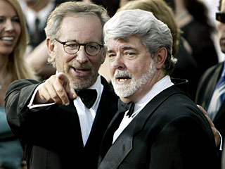
Good Luck!
Questions?
Email me any time: jlipsky@gmail.com
Grab some sample rubrics and lesson plans or download them from www.mrlipsky.com/korcos-2014
Do you teach media classes? Let’s network.
Be sure to take advantage of any media teacher, classes, tech people at your school

